Slide 1
LAB 7

Slide 2
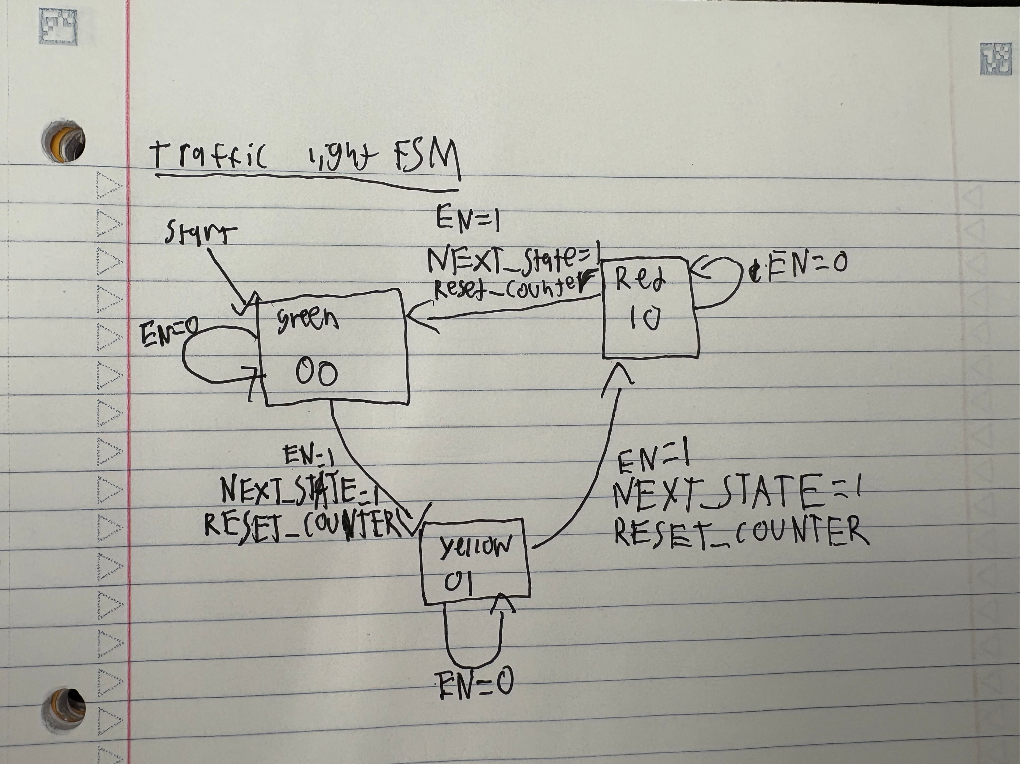
FSM Diagram

Slide 3
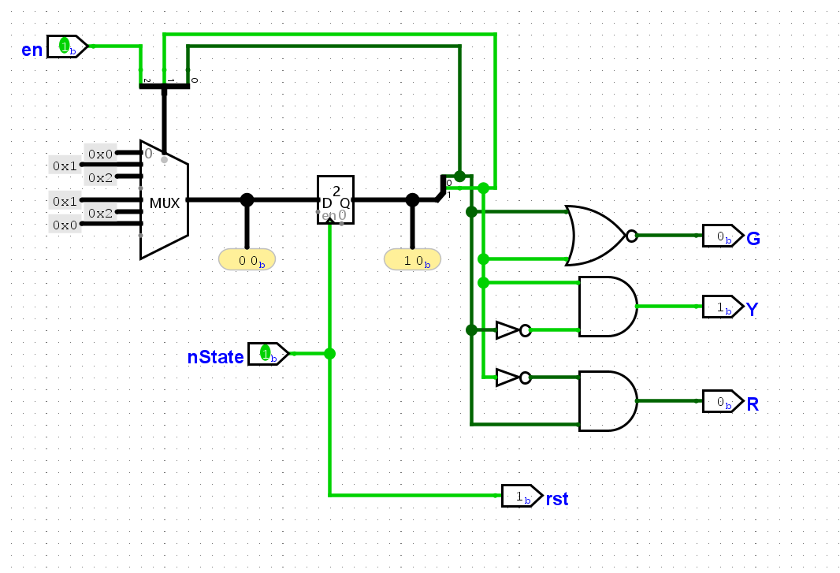
FSM

Slide 4
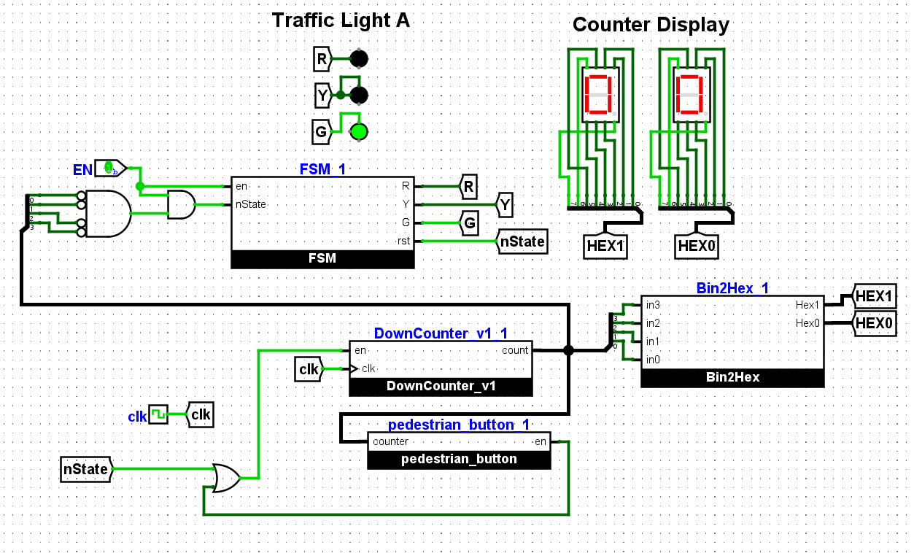
MAIN CIRCUIT DIAGRAM

